Slide 1
CompTIA A+ Certification 801 Support Skills
Unit 1.6 Output and
Multimedia Devices

Slide 2
Distinguish CRT and flat panel display technologies
Install and configure video cards
Install and configure sound cards, microphones, and speakers
Describe the functions and capabilities of multimedia devices (tuner cards, capture cards, digital cameras, and webcams)
Unit 1.6 Output and Multimedia Devices
Slide <number>

Slide 3
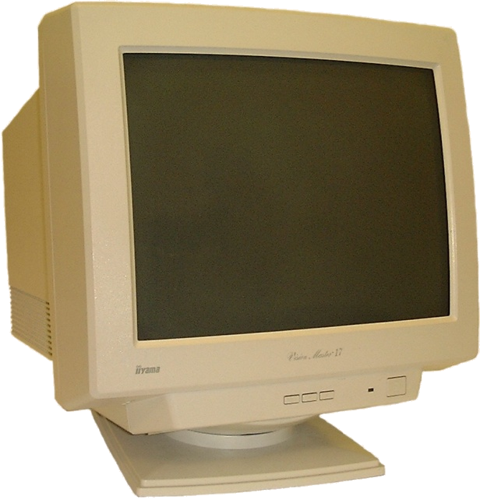
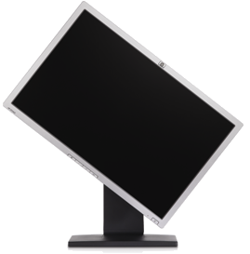
Display Devices
CRT Monitors
  Analog signal
  Variable resolution
  No longer widely available
Liquid Crystal Display
  Digital signal (most have converters)
  Native resolution
  LED
  OLED (Organic LED)
Projectors
  LCD
  DLP (Digital Light Processing)
Plasma
Unit 1.6 Output and Multimedia Devices
Slide <number>

Slide 4
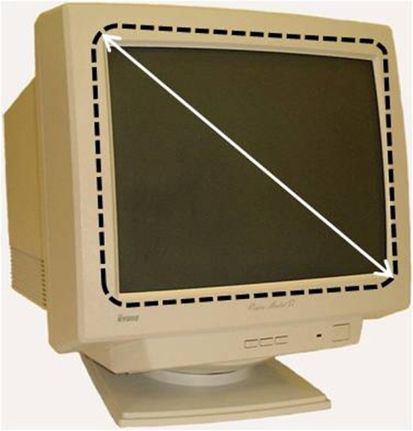
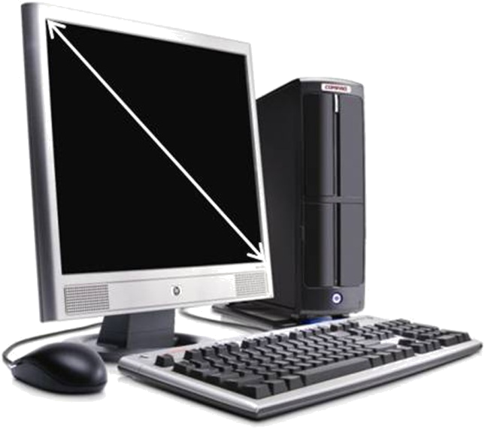
Comparing Display Technologies
Resolution
Screen size / viewable area
Aspect ratio
Refresh rate
Response rate
Brightness, Contrast Ratio, and Illuminance
Viewing angle
Matte versus gloss
Unit 1.6 Output and Multimedia Devices
Slide <number>

Slide 5
Adjusting the Image
The following settings apply to both CRTs and LCDs:
  Brightness and contrast - adjust the image
  Color - calibrate the monitor to display colors accurately
  Reset - apply the factory default settings
The following settings apply only to CRT monitors:
  Display area - size and position of the image
  Geometry - adjust the orientation of the picture and make edges straight as possible (pincushion and keystone)
  Moiré - cancel interference patterns (wavy lines); this is usually set to automatic
  Convergence - adjust if there are colored "shadows" around text and lines
  Degauss - use if the picture is "fuzzy" (this demagnetises demagnetizes the monitor)
  V-hold - adjust if the picture scrolls uncontrollably
Unit 1.6 Output and Multimedia Devices
Slide <number>

Slide 6
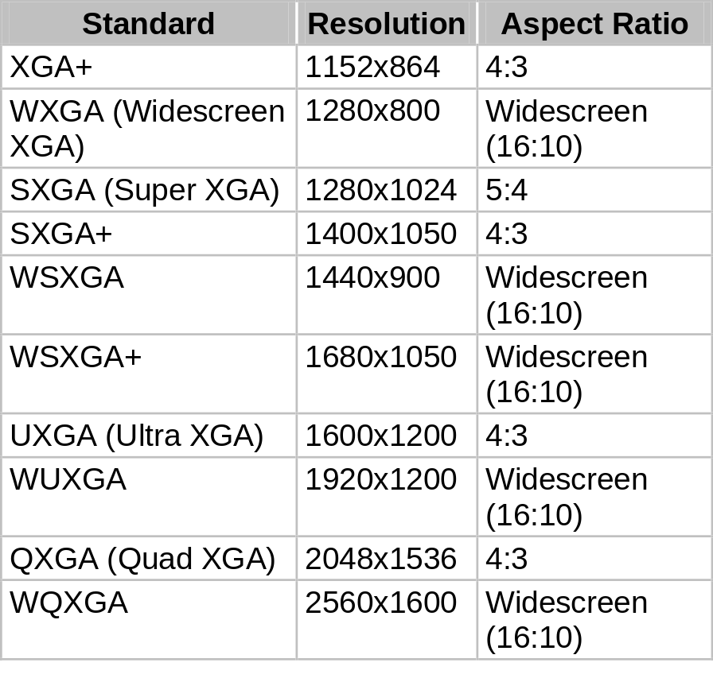
VGA Standards
VGA (640x480)
SVGA (800x600)
XGA formats
Widescreen formats
Unit 1.6 Output and Multimedia Devices
Slide <number>

Slide 7
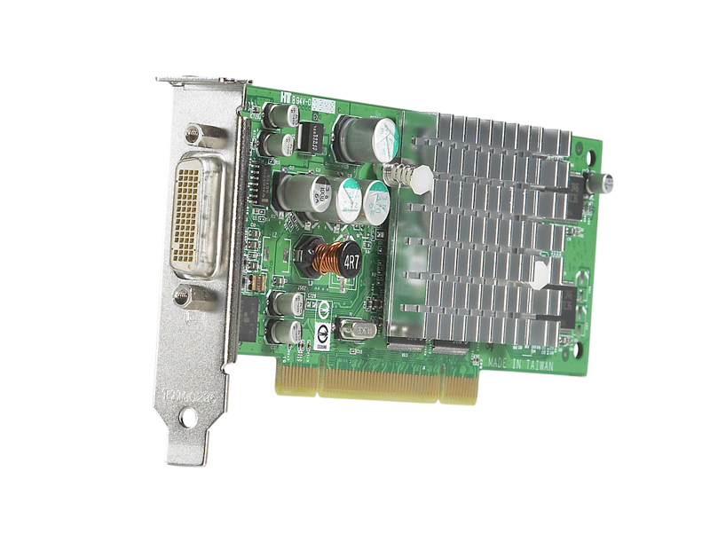
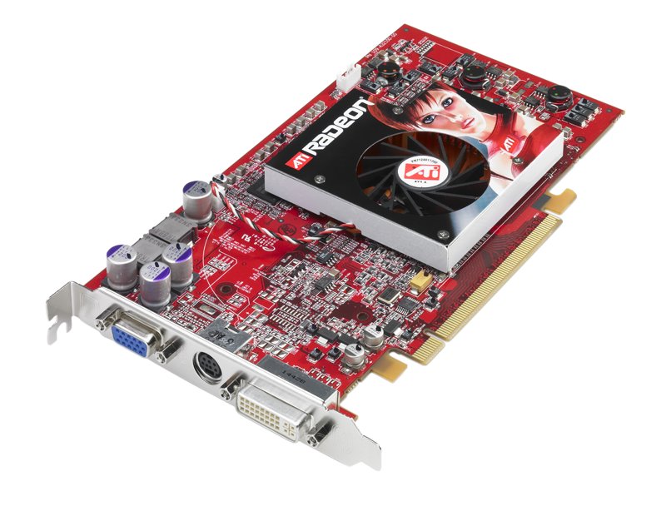
Video Adapter Components
Components
  DAC
  GPU
  Memory
  BIOS
DirectX
Color depth
Interface (AGP / PCIe)
Multi-monitor
Unit 1.6 Output and Multimedia Devices
Slide <number>

Slide 8
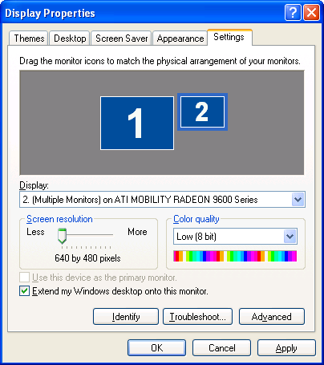
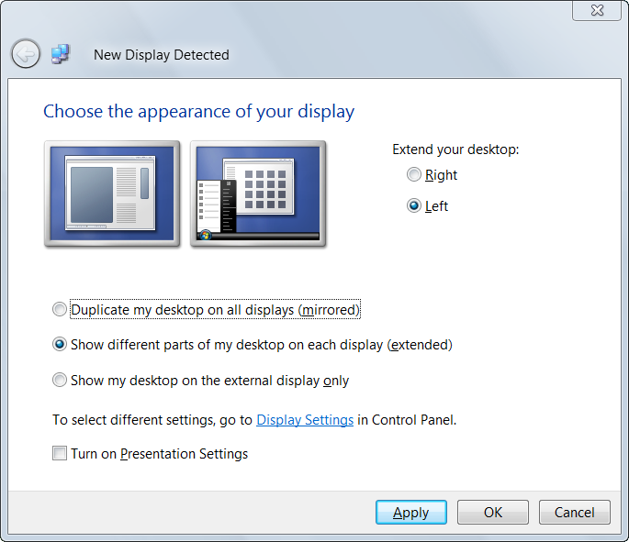
Multiple Displays
Using two displays alternately or simultaneously
Extend desktop
Use a presentation device (with a laptop)
Configure different resolution etc on each display
Unit 1.6 Output and Multimedia Devices
Slide <number>

Slide 9
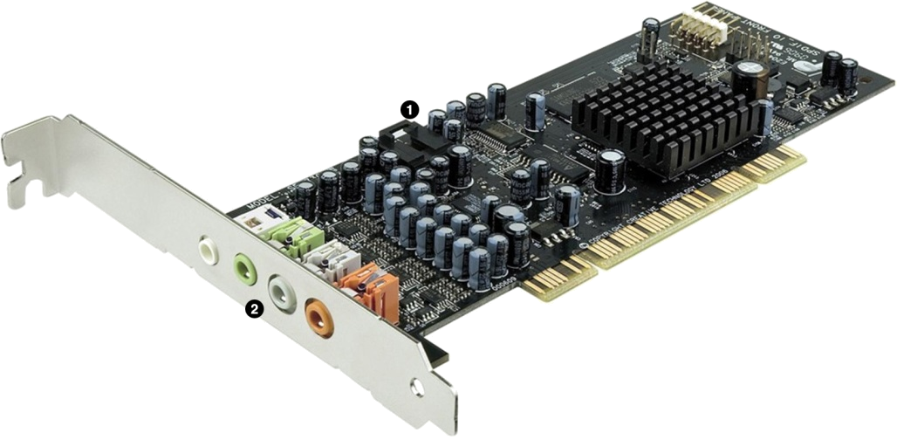
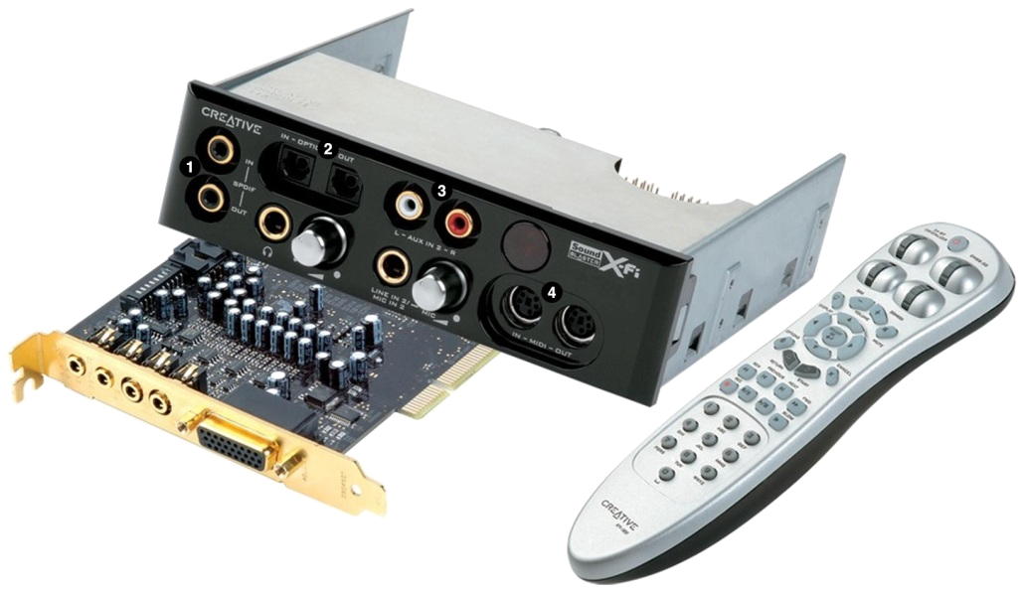
Audio Devices
Sound card features
Playback
  Speakers / headphones
  Surround sound support
  MIDI
Recording sound
  Microphone / line in / MIDI
  Distortion and noise (THD and SNR)
  Recording quality (sampling frequency)
Unit 1.6 Output and Multimedia Devices
Slide <number>

Slide 10
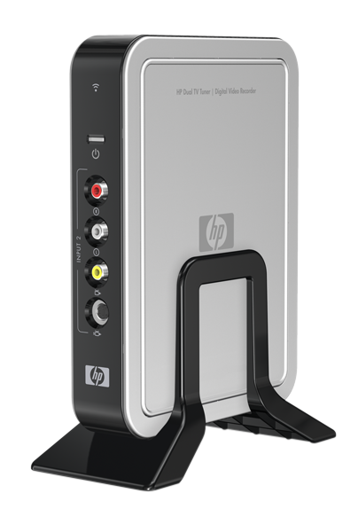
Multimedia Input Devices
TV Tuners
  Capture broadcast TV and radio (DVR)
  Interface to antenna or set-top box
  “Media Center”
  Internal or external
  Remote control
Digital cameras
Webcams
Camcorders
Unit 1.6 Output and Multimedia Devices
Slide <number>

Slide 11
Distinguish CRT and flat panel display technologies
Install and configure video cards
Install and configure sound cards, microphones, and speakers
Describe the functions and capabilities of multimedia devices (tuner cards, capture cards, digital cameras, and webcams)
Unit 1.6 Output and Multimedia Devices
Slide <number>

Slide 12
Lab 4 Connecting Peripheral Devices
Unit 1.6 Output and Multimedia Devices
Slide <number>

